Slide 1
CS-468 Software Quality Assurance & Testing
Week 15

Slide 2
Static Testing - Definition
static testing is a human testing technique that does not involve executing or running the program or software product. Instead it involves, checking or monitoring the software at each phase of Software Development Life Cycle.
Static testing is a type of software testing that is focused on evaluating the quality of a system or application without executing the code. It is an important aspect of software testing as it helps identify defects and issues early in the development process and ensures that the system is of high quality.

Slide 3
Why Is Static Testing Important?
To identify defects early: This testing helps identify defects and issues early in the development process, which allows organizations to fix them before the system deployed. This saves time and resources in the long run and ensures that the system is of high quality.
To improve code quality: This testing also helps improve the quality of the code by identifying issues such as syntax errors, coding standards violations, and design flaws.
To reduce maintenance costs: This testing helps reduce maintenance costs by identifying and fixing defects early in the development process.

Slide 4
Static Testing - Types
Reviews: A review is a process of examining the software or its documentation to identify defects or quality issues. There are several types of reviews, including formal reviews, informal reviews, walkthroughs, and inspections.
Static analysis: Static analysis involves analyzing the software without executing the code to find defects, security vulnerabilities, or performance issues. There are several tools available for performing static analysis, such as SonarQube, PMD, and FindBugs.
Code inspection: Code inspection involves reviewing the source code to find defects, coding standards violations, or other issues. Code inspection is usually done manually by a team of developers.
Document review: Document review involves reviewing the software documentation to ensure that it is complete, accurate, and up-to-date. Document review is usually done by technical writers or subject matter experts.
Modeling: Modeling involves creating models of the software or the system to identify defects or inconsistencies. Modeling can be done using various techniques, such as data flow diagrams, state diagrams, and use case diagrams.

Slide 5
Static Testing - Techniques
Reviews: Reviews are a process of examining the software artefacts to identify issues and defects. Different types of reviews can perform such as code review, requirements review, design review, etc.
Walkthroughs: Walkthroughs are an informal type of review where the developer presents the code or document to the team to receive feedback and suggestions.
Inspections: Inspections are a formal type of review where the team follows a predefined process to examine the software artefacts and identify issues.

Slide 6
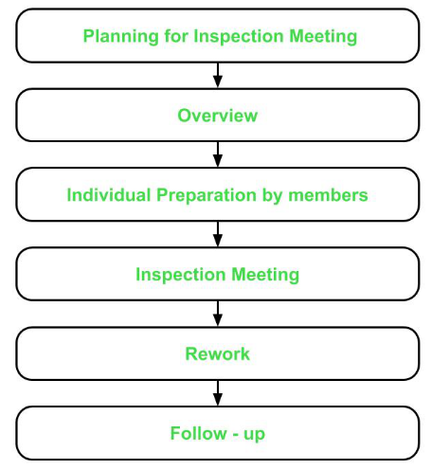
Static Testing - Techniques
Software Inspections:
Inspection process is performed in the earlier stages of the SLDC and is applied to a specific part of product like SRS, code, product design. etc. It involves manually examining the various components of the product at the earlier stages. The software inspection process comprises six phases which are as follows :

Slide 7
Static Testing - Techniques
Planning for Inspection Meeting –
This phase focuses on identifying the product to be inspected and the objective of this inspection.
A moderator – who manages the entire inspection process, is assigned in this phase.
The assigned moderator checks if the product is ready for inspection or not. The moderator also selects the inspection team and assigns them their roles.
Moderator also schedules the inspection meeting and distributes the required material to the inspection team.
Overview –
In this phase, the inspection team is given all the background information for the inspection meeting.
The author – who is the coder or designer responsible for developing the product presents his logic and reasoning for the product including the product’s functions, its intended purpose and the approach or concept used while developing it.
It is made sure that each member of the inspection team has understood and is familiar to the objectives and purpose of the inspection meeting that is to be held.

Slide 8
Static Testing - Techniques
Individual Preparation by members –
In this phase, the members of the inspection team individually prepare for the inspection meeting by studying the material provided in the earlier phases.
The team members identify the potential errors or bugs in the product and record them in a log. The log is finally submitted to the moderator. The moderator then compiles all the logs received from the members and sends a copy of it to the author.
The inspector – who is the person responsible for checking and identifying errors and inconsistencies in the documents or programs, reviews the product and records any problems found in it (both general and area-specific). The inspector records the problems or issues on a log along with the time spent on preparation.
The moderator reviews the logs to check if the team is ready and prepared for the inspection meeting or not.
Finally, the moderator submits all the compiled logs to the author.
Inspection Meeting –
This phase involves author’s discussion on the issues raised by the team members in the compiled log.
Members arrive at a decision of whether the issue raised is an error or not.
Moderator concludes the meeting and provides a summary of the meeting – which is a list of errors found in the product and are to resolved by the author.

Slide 9
Static Testing - Techniques
Rework –
Rework is carried out by the author according the summary list presented by the moderator in the previous phase.
The author fixes all the bugs and reports to the moderator
Follow – up –
Moderator checks if all errors have been resolved or not. The moderator then prepares a report. If all errors are fixed and addressed, the moderator releases the document.
Otherwise, unresolved issues are added to the report and another inspection meeting is scheduled

Slide 10
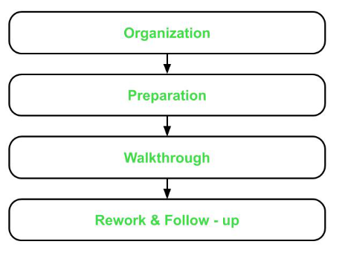
Static Testing - Techniques
Structured Walkthroughs :
This type of static testing is less formal and not so rigorous in nature. It has a simpler process as compared to inspection process. It involves the following four steps :

Slide 11
Static Testing - Techniques
Organization – This step involves assigning roles and responsibilities to the team selected for structural walkthroughs. The team can consist of the following members :
Coordinator – organizes and coordinates with all the members for the walkthrough related activities.
Presenter – introduces the item to be inspected.
Scribe – notes down all the issues and suggestions put forward by the members.
Tester – finds the defects or bugs in the item to be inspected.
Maintenance Oracle – focuses on future maintenance of the product.
Standards Bearer – evaluates conformance to the standards and guidelines.
User Representative – represents the needs and concerns of the user.
Preparation –
In this step, focus lies on preparing for the structural walkthroughs which could include thinking of basic test cases that would be required to test the product.
Walkthrough –
Walkthrough is performed by a tester who comes to the meeting with a small set of test cases.
Test cases are executed by the tester mentally and results are noted down on a paper or a presentation media.

Slide 12
Static Testing - Techniques
Rework and Follow – up –
This step is similar to that of the last two phases of the inspection process.
If no bugs are detected, then the product is approved for release. Otherwise, errors are resolved and again, a structured walkthrough is conducted.

Slide 13
Static Testing - Techniques
Technical Reviews:
It is a higher level technique as compared to the inspection or walkthrough technique because it also involves management. This technique is used to assess and evaluate the product by checking its conformance to the development standards, guidelines and specifications. It does not have a defined process and most of the work is carried out by the moderator as discussed below :
Moderator gathers and distributes the material and documentation to all team members.
Moderator also prepares a set of indicators to evaluate the product with respect to the specifications and already established standards and guidelines :
consistency
documentation
adherence to standards
completeness
problem definition and requirements
The results are recorded in a document which includes both defects as well as suggestions.
Finally, the defects are resolved and the suggestions are taken into account for improving the product.

Slide 14
Static Testing - Tools
Code review tools: These tools are used to review the source code to find defects or vulnerabilities. Examples include Code Collaborator, Crucible, and Gerrit.
Syntax checkers: These tools check the source code for syntax errors, coding standards violations, and other potential issues. Examples include JSLint, ESLint, and PyLint.
Bug tracking tools: These tools help to track and manage defects found during static testing. Examples include Bugzilla, JIRA, and Mantis.
Automated documentation generators: These tools generate documentation automatically from the source code to help improve the quality of the documentation. Examples include Doxygen and NaturalDocs.
Static analysis tools: These tools analyze the source code to find defects, security vulnerabilities, or performance issues. Examples include SonarQube, PMD, and FindBugs.
Model checking tools: These tools check the model of the software to find defects or inconsistencies. Examples include Alloy and NuSMV.

